Slide 1
Humanities and engineering
Special Interest Group
SnapPapers
Ramsha Naeem
Harsh Sanjaykumar Pandya
Alejandro Santoscoy Rivero
Sithija Wijesinghe

Slide 2
The objective
Create a webpage for the Humanities and Engineering special interest group.
The members should be able to self manage their profile.
Researchers should be able to collaborate with each other.
The website should be easy to access and use.

Slide 3
Features initally proposed
Homepage
Highlights
Visualizations
Contact form
Profile
Create and update
Login and logout
Delete
Networking
Search and filters
Chat
Research papers
Search and filters
Linking
Visualizations
Trends
Geographical
Interests
Bilingual

Slide 4
Features implemented
Homepage
Highlights
Visualizations
Contact form
Profile
Create and update
Login and logout
Delete
Networking
Search and filters
Forums
Group researchers by interests
Research papers
Search and filters
Linking
Web scraping
Visualizations
Trends graph
Interactive geographical map
Interactive interests word cloud
Bilingual

Slide 5
Changes to original proposal
Networking
Chat was discarded
Forums were added
Research papers
Web scraping
Profile
Link and unlink papers manually was moved to future work

Slide 6
Website demonstration

Slide 7
What can be improved?
Profile
Link and unlink papers manually was moved to MVP 2
Responsiveness
Multiple device support (different screen sizes)
Search engine optimization (SEO)
Animations

Slide 8
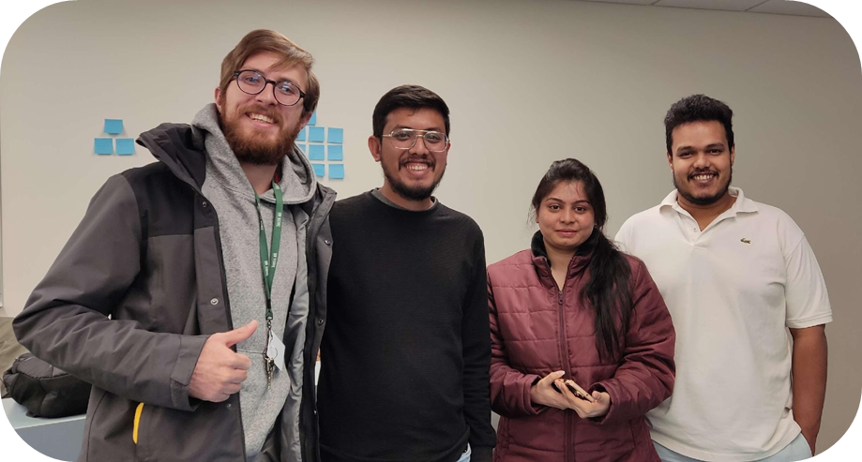
Thank you
SnapPapers

